Slide 1
7 Algorithm design and problem-solving
Trace tables

Slide 2


Trace tables
Tracing execution: A vital skill for understanding program flow and testing the accuracy of an algorithm for logic.
It involves examining a printed extract of program code and running thorough the program:
Take each line at a time and write the current state of each variable in a trace table.
Note down any output the program produces.
Each variable present in the program should have its own column in the trace table.
A new row should be added under any column if the state of a variable changes.
Trace tables are an excellent way to track down logic errors in a problem.

Slide 3
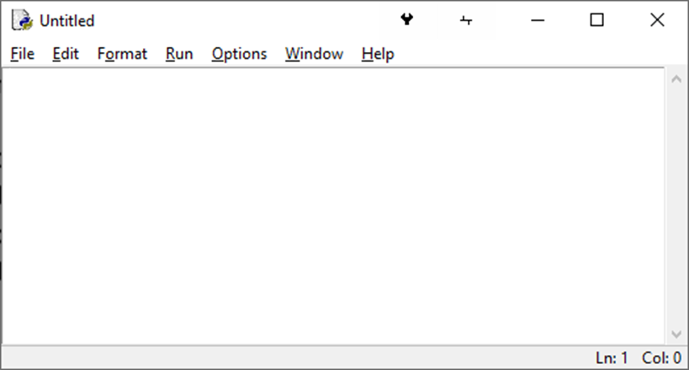
number = print("Enter a number")
total = 1
for counter = 1 to number
total = total * counter
next counter
output(total)
Start by identifying any variables in the program and put each one in its own column to create a trace table.

Slide 4
number | counter | total
number = print("Enter a number")
total = 1
for counter = 1 to number
total = total * counter
next counter
output(total)
Start by identifying any variables in the program and put each one in its own column to create a trace table.

Slide 5
number | counter | total
number = print("Enter a number")
total = 1
for counter = 1 to number
total = total * counter
next counter
output(total)
Start by identifying any variables in the program and put each one in its own column to create a trace table.

Slide 6
number | counter | total
number = print("Enter a number")
total = 1
for counter = 1 to number
total = total * counter
next counter
output(total)
Start by identifying any variables in the program and put each one in its own column to create a trace table.

Slide 7
number | counter | total
number = print("Enter a number")
total = 1
for counter = 1 to number
total = total * counter
next counter
output(total)
Output window:
Note: When the first line of code executes – number = print("Enter a number") – assume the user enters the integer 5.

Slide 8
number | counter | total
5
number = print("Enter a number")
total = 1
for counter = 1 to number
total = total * counter
next counter
output(total)
Output window:
Enter a number
5
Note: When the first line of code executes – number = print("Enter a number") – assume the user enters the integer 5.

Slide 9
number | counter | total
5 |  | 1
number = print("Enter a number")
total = 1
for counter = 1 to number
total = total * counter
next counter
output(total)
Output window:
Enter a number
5
Note: When the first line of code executes – number = print("Enter a number") – assume the user enters the integer 5.

Slide 10
number | counter | total
5 | 1 | 1
number = print("Enter a number")
total = 1
for counter = 1 to number
total = total * counter
next counter
output(total)
Output window:
Enter a number
5
Note: When the first line of code executes – number = print("Enter a number") – assume the user enters the integer 5.

Slide 11
number | counter | total
5 | 1 | 1
 |  | 1
number = print("Enter a number")
total = 1
for counter = 1 to number
total = total * counter
next counter
output(total)
Output window:
Enter a number
5
Note: When the first line of code executes – number = print("Enter a number") – assume the user enters the integer 5.

Slide 12
number | counter | total
5 | 1 | 1
 | 2 | 1
number = print("Enter a number")
total = 1
for counter = 1 to number
total = total * counter
next counter
output(total)
Output window:
Enter a number
5
Note: When the first line of code executes – number = print("Enter a number") – assume the user enters the integer 5.

Slide 13
number | counter | total
5 | 1 | 1
 | 2 | 1
number = print("Enter a number")
total = 1
for counter = 1 to number
total = total * counter
next counter
output(total)
Output window:
Enter a number
5
Note: When the first line of code executes – number = print("Enter a number") – assume the user enters the integer 5.

Slide 14
number | counter | total
5 | 1 | 1
 | 2 | 1
 |  | 2
number = print("Enter a number")
total = 1
for counter = 1 to number
total = total * counter
next counter
output(total)
Output window:
Enter a number
5
Note: When the first line of code executes – number = print("Enter a number") – assume the user enters the integer 5.

Slide 15
number | counter | total
5 | 1 | 1
 | 2 | 1
 | 3 | 2
number = print("Enter a number")
total = 1
for counter = 1 to number
total = total * counter
next counter
output(total)
Output window:
Enter a number
5
Note: When the first line of code executes – number = print("Enter a number") – assume the user enters the integer 5.

Slide 16
number | counter | total
5 | 1 | 1
 | 2 | 1
 | 3 | 2
number = print("Enter a number")
total = 1
for counter = 1 to number
total = total * counter
next counter
output(total)
Output window:
Enter a number
5
Note: When the first line of code executes – number = print("Enter a number") – assume the user enters the integer 5.

Slide 17
number | counter | total
5 | 1 | 1
 | 2 | 1
 | 3 | 2
 |  | 6
number = print("Enter a number")
total = 1
for counter = 1 to number
total = total * counter
next counter
output(total)
Output window:
Enter a number
5
Note: When the first line of code executes – number = print("Enter a number") – assume the user enters the integer 5.

Slide 18
number | counter | total
5 | 1 | 1
 | 2 | 1
 | 3 | 2
 | 4 | 6
number = print("Enter a number")
total = 1
for counter = 1 to number
total = total * counter
next counter
output(total)
Output window:
Enter a number
5
Note: When the first line of code executes – number = print("Enter a number") – assume the user enters the integer 5.

Slide 19
number | counter | total
5 | 1 | 1
 | 2 | 1
 | 3 | 2
 | 4 | 6
number = print("Enter a number")
total = 1
for counter = 1 to number
total = total * counter
next counter
output(total)
Output window:
Enter a number
5
Note: When the first line of code executes – number = print("Enter a number") – assume the user enters the integer 5.

Slide 20
number | counter | total
5 | 1 | 1
 | 2 | 1
 | 3 | 2
 | 4 | 6
 |  | 24
number = print("Enter a number")
total = 1
for counter = 1 to number
total = total * counter
next counter
output(total)
Output window:
Enter a number
5
Note: When the first line of code executes – number = print("Enter a number") – assume the user enters the integer 5.

Slide 21
number | counter | total
5 | 1 | 1
 | 2 | 1
 | 3 | 2
 | 4 | 6
 | 5 | 24
number = print("Enter a number")
total = 1
for counter = 1 to number
total = total * counter
next counter
output(total)
Output window:
Enter a number
5
Note: When the first line of code executes – number = print("Enter a number") – assume the user enters the integer 5.

Slide 22
number | counter | total
5 | 1 | 1
 | 2 | 1
 | 3 | 2
 | 4 | 6
 | 5 | 24
number = print("Enter a number")
total = 1
for counter = 1 to number
total = total * counter
next counter
output(total)
Output window:
Enter a number
5
Note: When the first line of code executes – number = print("Enter a number") – assume the user enters the integer 5.

Slide 23
number | counter | total
5 | 1 | 1
 | 2 | 1
 | 3 | 2
 | 4 | 6
 | 5 | 24
 |  | 120
number = print("Enter a number")
total = 1
for counter = 1 to number
total = total * counter
next counter
output(total)
Output window:
Enter a number
5
Note: When the first line of code executes – number = print("Enter a number") – assume the user enters the integer 5.

Slide 24
number | counter | total
5 | 1 | 1
 | 2 | 1
 | 3 | 2
 | 4 | 6
 | 5 | 24
 | 6 | 120
number = print("Enter a number")
total = 1
for counter = 1 to number
total = total * counter
next counter
output(total)
Output window:
Enter a number
5
Note: When the first line of code executes – number = print("Enter a number") – assume the user enters the integer 5.

Slide 25
number | counter | total
5 | 1 | 1
 | 2 | 1
 | 3 | 2
 | 4 | 6
 | 5 | 24
 | 6 | 120
number = print("Enter a number")
total = 1
for counter = 1 to number
total = total * counter
next counter
output(total)
Output window:
Enter a number
5
Note: When the first line of code executes – number = print("Enter a number") – assume the user enters the integer 5.

Slide 26
number | counter | total
5 | 1 | 1
 | 2 | 1
 | 3 | 2
 | 4 | 6
 | 5 | 24
 | 6 | 120
number = print("Enter a number")
total = 1
for counter = 1 to number
total = total * counter
next counter
output(total)
Output window:
Enter a number
5
120
Note: When the first line of code executes – number = print("Enter a number") – assume the user enters the integer 5.

Slide 27
number | counter | total
5 | 1 | 1
 | 2 | 1
 | 3 | 2
 | 4 | 6
 | 5 | 24
 | 6 | 120
number = print("Enter a number")
total = 1
for counter = 1 to number
total = total * counter
next counter
output(total)
So, what is this program doing?
Output window:
Enter a number
5
120
Note: When the first line of code executes – number = print("Enter a number") – assume the user enters the integer 5.

Slide 28
number | counter | total
5 | 1 | 1
 | 2 | 1
 | 3 | 2
 | 4 | 6
 | 5 | 24
 | 6 | 120
number = print("Enter a number")
total = 1
for counter = 1 to number
total = total * counter
next counter
output(total)
What is this program doing?
It is outputting the factorial of the number entered.
Factorial 5 = 1*2*3*4*5 = 120
Output window:
Enter a number
5
120
Note: When the first line of code executes – number = print("Enter a number") – assume the user enters the integer 5.

Slide 29


